Slide 1


“Make better choices, every time”
Project Name: AutoLife Guardian
Subtitle: AI-Powered Pre-Decision Protection System
Team: Team Sentinel AI
Date: 23/03/2026

Slide 2

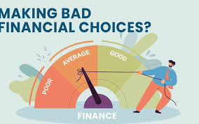
PROBLEM
1
People often make impulsive decisions that waste time and money and misalign with their goals. Most existing tools only provide feedback after the mistake has already happened, which is too late to prevent negative consequences.

Slide 3
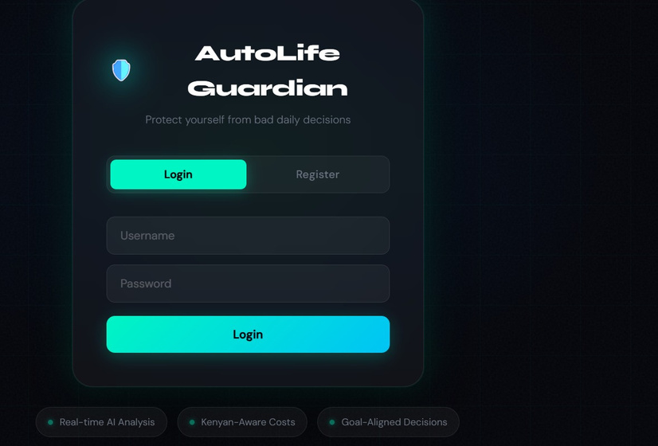
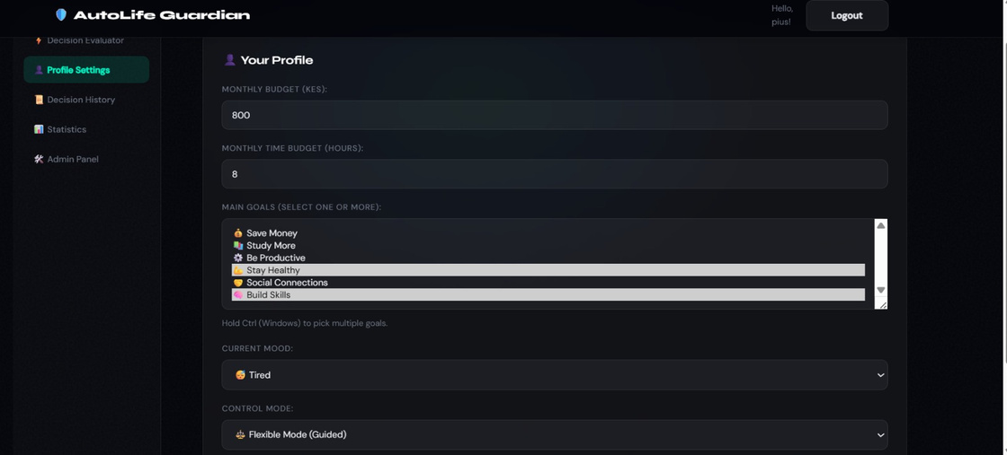
SOLUTION
2
Our AI system offers real-time guidance, helping users make smarter decisions in the moment, preventing wasted resources and keeping actions aligned with their goals.

Slide 4

KEY FEATURES
3
Tri-Factor Analysis: The "Decision Evaluator" analyzes the intersection of your time, money, and behavior to prevent impulsive actions that could derail your semester.
Smart Decision-Making Boost: Uses "One-Click Guidance" to provide personalized "Do Now" or "Ignore" suggestions, helping students manage cognitive load during busy exam seasons.
Persistent Life Score: Visualizes your progress through "Stats & Trends" and "Life Score" charts, turning the development of discipline into a trackable, rewarding experience.
Explainable Logic: Every AI decision includes a clear reason and confidence level so you understand the "why" behind the guidance.

Slide 5


SYSTEM ARCHITECTURE
4
Front End : React and Vite
Back End: Node j.s and Express
Database: MySQL
Security: jwt and bcrypt
AI Engine: Integrated Admin Panel for user/risk management
Governance: Groq (primary) DeepSeek (fallback)

Slide 6
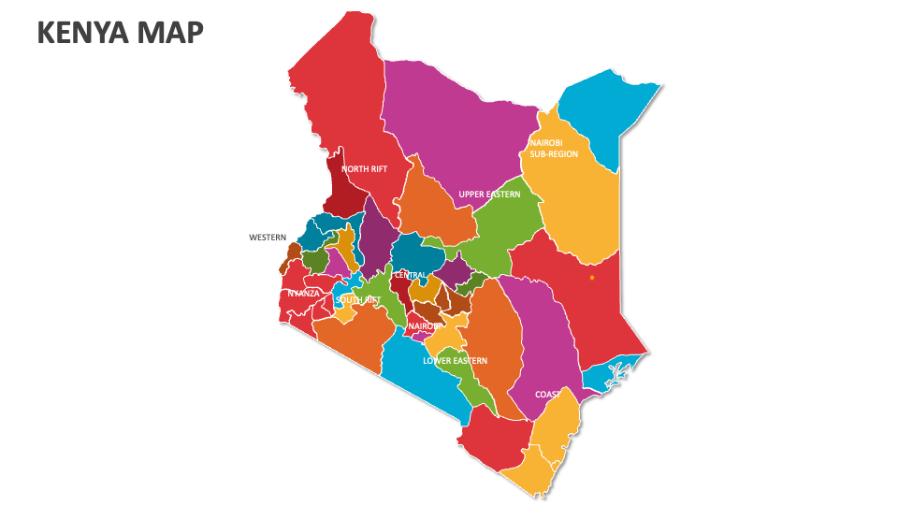
MARKET
5
AutoLife Guardian targets individuals seeking to make smarter decisions and better manage their time, money, and habits. This includes:
Students – managing study time, spending, and daily routines.
Young professionals – controlling impulsive purchases, work priorities, and lifestyle choices.
General consumers – anyone looking to improve decision-making and reduce mistakes in everyday life.

Slide 7

LIVE DEMO

Slide 8


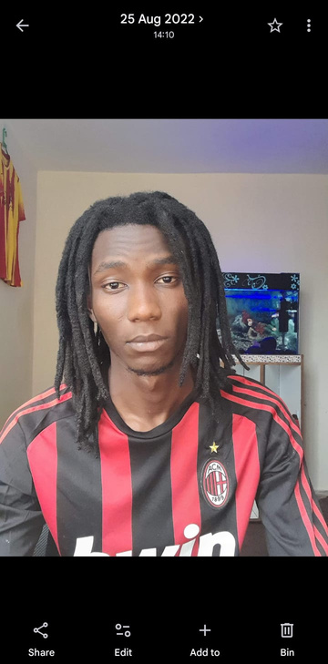
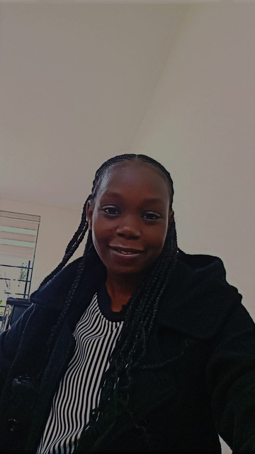
TEAM
6
Pius Karoki
Bachelor of Science in Computer Science
Fourth Year
Software Engineer and Mobile Developer
Calton Ariga
Bachelor of Science in Computer
Science
Third Year
Software Engineer and Mobile Developer
Stephen Otiende
Bachelor of Science in Business Information Technology
Fourth Year
Web Developer
Brenda Cherono
Bachelor of Science in Computer Science
Second Year
Software Engineer

Slide 9
IMPACT
7
Reducing wasted time and money – Helping individuals make smarter daily decisions.
Promoting responsible behavior and goal alignment– Encouraging accountability through guided choices and user overrides.
Supporting students and professionals – Improving study habits, work productivity, and financial decisions.
Fostering a healthier decision-making culture – Reducing impulsivity and promoting thoughtful choices in everyday life.

Slide 10


Slide 11

THANK YOU
“Make better choices, every time”

